Slide 1
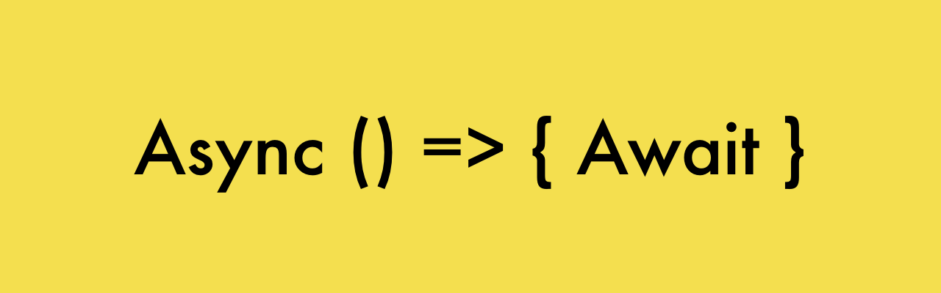

Slide 2
Introduction
They make async code look more like old-school synchronous code
First of all we have the async keyword, which you put in front of a function declaration to turn it into an async function.
An async function is a function that knows how to expect the possibility of the await keyword being used to invoke asynchronous code.
Await function is used to wait for the promise.
It could be used within the async block only.
It makes the code wait until the promise returns a result.
It only makes the async block wait.

Slide 3
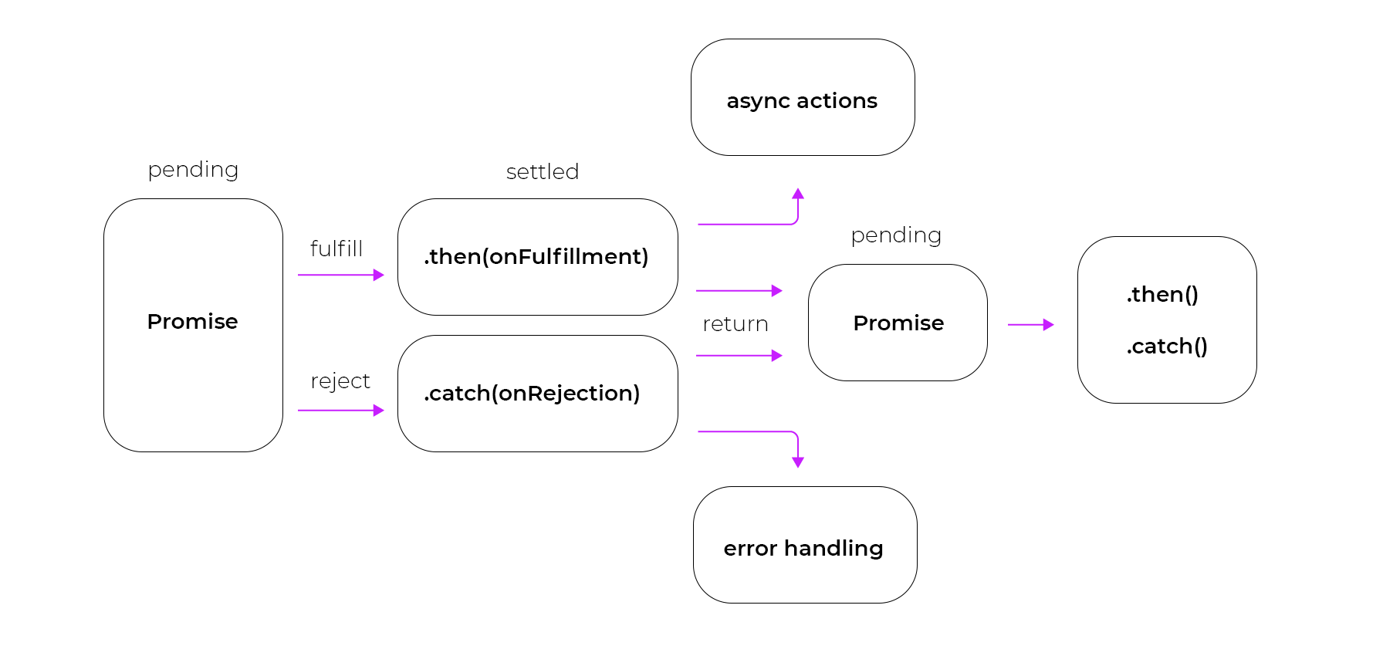
Promises

Slide 4
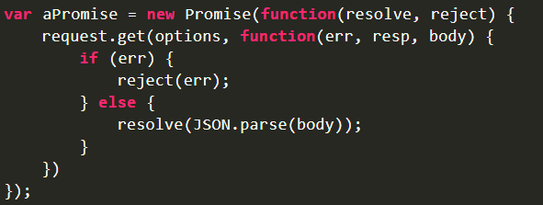
Promises
A Promise in means an action which will either be fulfilled or rejected.
Callbacks can be registered with the .then() to handle fulfillment and .catch() for rejection.
The .then() can be chained to handle the fulfillment and rejection whereas .catch() can be used for handling the errors(if any).

Slide 5
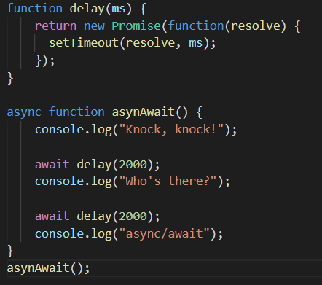
Async and Await
Here, the async keyword turns the asynAwait function into async
We have the await keyword to wait for the promise to return a result from the delay function
The output is basically the console.log statements outputted with a interval of 2 seconds
Without the await keyword, they would be displayed without any interval.

